Slide 1
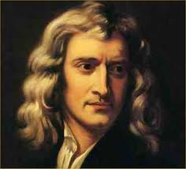


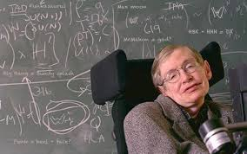
Welcome to Grade 12 Physics!
Course Code: SPH4U
Teacher: Mr. Shaw

Slide 2
Course Information:
●Course Website: Desire 2 Learn
● Course Outline on D2L
● Postings: Lessons, Homework, Announcements, Calendar,
● Major assignments will be submitted on Turnitin- LATE ASSIGNMENTS NOT ACCEPTED! Refer to Science Dept Policy

Slide 3
Course Information Continued:
● Textbook Nelson 12 Physics
* You will have access to an online book and pdf files posted on Angel

Slide 4
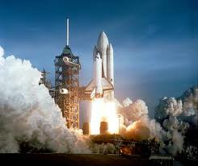
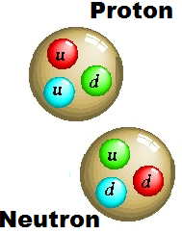
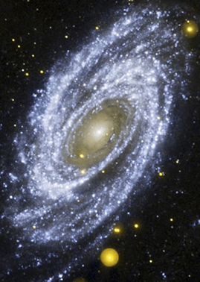
Physics is the study of how energy and matter interact….
…on scales ranging from
the tiniest particles….
The Large Hadron Collider Rap!
…to the entire universe!
The Large Hadron Collider Rap!

Slide 5

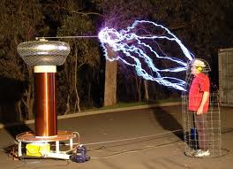

Topics we will study…
Introductory Unit:
Kinematics Review
Lab Skills & Data Analysis
Unit 1: Dynamics
Unit 2: Energy and Momentum
Unit 3: Gravitational, Electric and Magnetic Fields
Unit 4: Wave Nature of Light
Unit 5: Quantum Physics and Special Relativity

Slide 6
Autobiography
Please tell me about yourself!
1. What is your reason for taking this course?
2. Are you planning to go to university next year? What course would you like to pursue?
3. What are your future career plans?
3. Please list your last math and physics courses and your approximate grade in those courses.
4. What challenges do you think you may face in the course?
5. How do you plan to be successful in the course?
6. Do you have a cell phone that you can use for some in-class activities?
7. Please tell me three things you think I should know about you. You may discuss hobbies, interests, health concerns, etc.

Slide 7
● Questions so far?
HOMEWORK:
Complete autobiography.
Complete the Review Worksheet handout.
Begin work on Textbook review Questions from Day 1.
Best Wishes for a Phun and Phantastic Physics Phantasia this year!

